Slide 1

Follow-Up Behavioral Assessment Training:
Behavior Assessment, Vaginal Practices, Social Influences Assessment, Social Benefit Log, Study Exit Assessment
Ariana Katz
WGHI/RTI International
San Francisco, CA

Slide 2
Agenda
Review of follow-up forms, highlighting guidance for new or unique questions from baseline forms and/or from ASPIRE

Slide 3
Follow-Up Behavior Assessment CRF
DOMAINS COVERED*
  Information about primary sex partner:
    sex with partner
    disclosure re study and ring
    circumcision, HIV status, ARVs
    clinic involvement
  Other sexual partners
  Intimate partner violence**
  Participant sexual behavior
  Condom use
  Condom use
  Vaginal ring use
  Acceptability of ring
  Social benefit trigger
  Social impact trigger
  *All questions asked of acceptors and non-acceptors unless specified with skip patterns
  ** Blue= New Topics

Slide 4
Follow-Up Behavior Assessment CRF cont.
PUEV or Early Termination:
  Ring worries*
  Ring storage
  Changes in vagina due to ring
  Preference for ring distribution frequency (1 vs 3)
  HIV prevention method preference
  Primary partner’s HIV prevention method preference
  * Moved from Ring Worries CRF to BA CRF and cut back to just one question (overall worry). Administered to both acceptors and non-acceptors

Slide 5
NEW Follow-Up Behavior Assessment Questions
Intimate partner violence (IPV)*
  May influence decision to accept/not accept or use/not use the ring
  Provide information on IPV for future interventions and analyses
Social benefit trigger
  Provide information on positive benefits of study participation or ring use
11 | The next questions are about your relationship with your primary sex partner or any other partners. In the past 3 months, has your primary sex partner or ANY other current or previous partner ever:
11a | Slapped you, hit you with a fist or something else, or beaten you? | ₁ Yes → Complete a Social Impact Log, if applicable ₂ No
11b | Kicked, dragged, pushed, pulled your hair, choked or burnt you? | ₁ Yes→ Complete a Social Impact Log, if applicable ₂ No
12 | In the past 3 months, has your primary sex partner or ANY other current or previous partner ever forced you to have sex by holding you down or hurting you? | ₁ Yes→ Complete a Social Impact Log, if applicable ₂ No
18. | At any time in the past 3 months, have you experienced a social benefit related to your study participation? | ₁ Yes → If yes, complete Social Benefits Log ₂ No
*Capture only harm caused by sex partners (not a stranger or other non-partner)

Slide 6
NEW Follow-Up Behavior Assessment Questions
PUEV or Early Termination Visit Only
Ring storage
  Understand feasibility of storing multiple rings
Changes in vagina due to ring
  Understand perceived changes in vaginal state
  Determine if changes are perceived negatively
Preference for ring distribution frequency (1 vs 3 at a time)
  Inform future implementation projects
21 | How difficult was it to store the ring(s) at home? | ₁ very difficult ₂ somewhat difficult ₃ not at all difficult ₄ not applicable - did not store ring(s) at home ₅ not applicable - never used the ring during HOPE → If not applicable, skip to item 23.
22 | Have you noticed any of the following changes in your vagina while wearing the vaginal ring?
 | 22a. vagina wetter | ₁ Yes ₂ No → If no, skip to item 22b.
 | 22a1. Was this change a problem for you? | ₁ Yes ₂ No
 | 22b. vagina drier | ₁ Yes ₂ No → If no, skip to item 22b.
 | 22b1. Was this change a problem for you? | ₁ Yes ₂ No
 | 22c. change in scent or smell from the vagina | ₁ Yes ₂ No → If no, skip to item 22b.
 | 22c1. Was this change a problem for you? | ₁ Yes ₂ No
23 | Do you prefer to receive one ring or three rings at a time? | ₁ prefer receiving 1 ring at a time ₂ prefer receiving 3 rings at a time ₃ no preference
Notes:
PURPOSE:

Slide 7
NEW Follow-Up Behavior Assessment Questions
PUEV or Early Termination Visit Only
HIV prevention method preference*
  Understand participant’s preference of ring versus condom for HIV prevention
Primary partner’s HIV prevention method preference
  Understand partner’s preference of ring versus condom for HIV prevention
24 | As a method to prevent HIV, which do you prefer to use? | ₁ ring ₂ condom ₂ neither ₄ both equally
25 | What does your primary partner prefer? | ₁ ring ₂ condom ₂ neither ₄ both equally ₅ don’t know
*Make sure to emphasize preference, not what they think they should say based on recommendations and prevention messages (we want to avoid getting the socially desirable response)
Notes:
PURPOSE:

Slide 8
Follow-Up Behavior Assessment: Notes
Reconciliation between counseling and behavioral forms not expected
Follow-up after interview if participant reports she is bothered by or worried about wearing the ring, has had difficulty storing rings at home, or has noticed changes in her vagina since starting to use the ring
  Interviewer, a counselor, or a clinician (as determined by each site) can follow-up

Slide 9
Follow-Up Vaginal Practices CRF Questions
DOMAINS COVERED*
  Methods to control bleeding/spotting
  What is inserted in the vagina
  *Removed question asking if they like wearing ring during menses. Kept similar question in ACASI.
Notes:
Taken from ACASI questions

Slide 10
NEW Follow-Up Vaginal Practices Questions
What insert in vagina
  Added traditional medicines
  Added anything to make vagina dry or tight
NOTE: If participant reports potentially harmful vaginal practices, clinician should follow up on these items when possible when reviewing the ring use instructions with the participant
2b. | Traditional medicines | ₁ Yes ₂ No
2c. | Anything to make the vagina dry or tight | ₁ Yes ₂ No
Notes:
Taken from ACASI questions

Slide 11
NEW Follow-Up Vaginal Practices Questions
What insert in vagina
  Added traditional medicines
  Added anything to make vagina dry or tight
NOTE: If participant reports potentially harmful vaginal practices, clinician should follow up on these items when possible when reviewing the ring use instructions with the participant
2b. | Traditional medicines | ₁ Yes ₂ No
2c. | Anything to make the vagina dry or tight | ₁ Yes ₂ No
Additional NOTE:
Any follow-up should not add any additional procedure or time to current visit
Clinician should take care to bring up in discreet, non-judgmental way
Notes:
Vaginal practices additions taken from ACASI questions

Slide 12
Follow-Up Vaginal Practices: Notes
Potentially harmful vaginal practices may be appropriate for the clinician to follow-up on with the participant.
If previous education and counseling about vaginal practices has been provided, additional counseling should build off of earlier conversations with the participant.
As with other types of counseling in HOPE, this should be done in a non-judgmental, client-centered way.
Notes:
Follow-up to harmful practices – participants may be less likely to report any harmful practices during follow-up CRF interviews if they feel they are being punished with extra visits or procedures. However, we advise that the behavioral questionnaires be administered early on in the visit, prior to counseling. This may also mean before clinical procedures and before provision of a new ring, if applicable, depending on your site. Any concerning issues mentioned during the interview may then be addressed during the same visit. Sites should not be scheduling separate visits to follow-up.
When bringing up anything that was brought up in CRF interviews, it is important to bring up discreetly so the participant doesn’t feel like they are being questioned on their responses, which may lead them to avoid mentioning those items in the next interview.

Slide 13
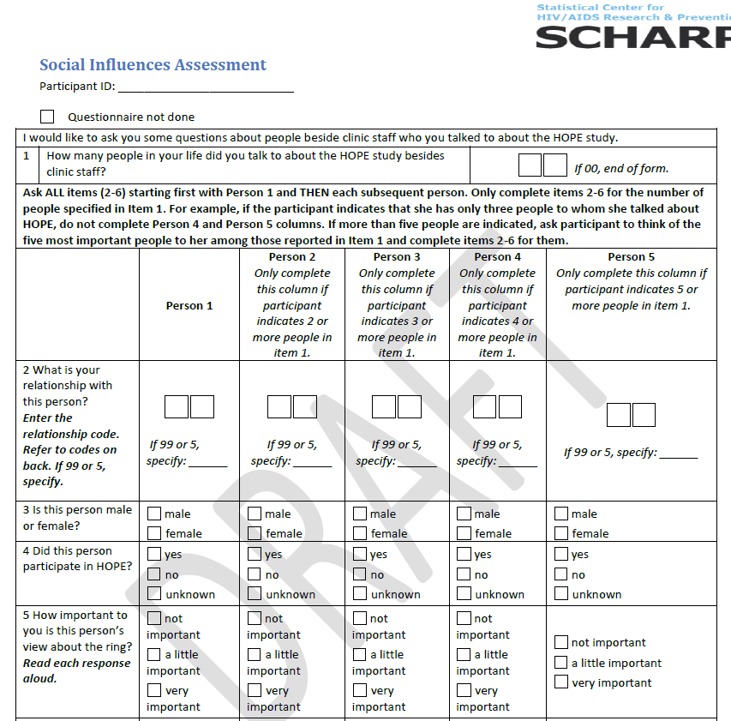
Social Influences Assessment
Purpose: Identify people in participant’s life who may have influenced study participation and/or use of the study ring
No changes from ASPIRE

Slide 14
NEW Social Benefit Log
Purpose: Capture any positive change, event, or experience in her life related to her study participation or ring use.
Similar to the Social Impact Log
  captures positive events due to study participation rather than negative events

Slide 15
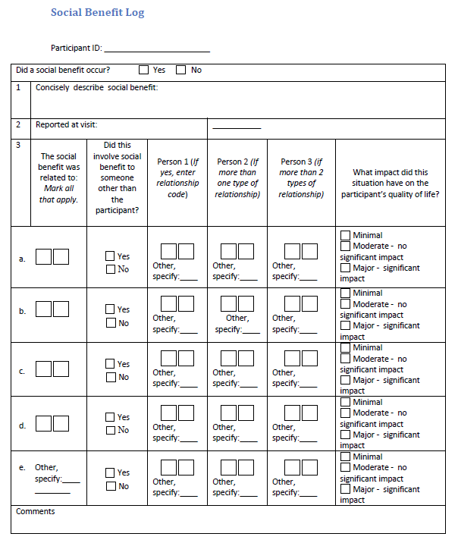
NEW Social Benefit Log
Probed for quarterly with item # 18 on Follow-Up Behavior Assessment
Study staff should fill out one form for all social benefits experienced during the 3 months since last study visit
Capture up to 3 additional people per event who benefited from the event besides the participant

Slide 16
Study Exit Assessment
DOMAINS covered:
Study activity participation
Partner study activity participation
Familiarity with other participants
Sexual behavior and condom use
Dislikes about study
Ring used by someone else
Future ring use interest

Slide 17
NEW Study Exit Assessment Questions
Ring used by someone else
  Gain insight into ring sharing or rings being stolen by others
  Inform on others’ interest in the ring
Future ring use interest
  Insight into acceptability of the ring and interest in the ring if available in the future
8 | Were any of the rings dispensed to you ever used by someone else? | ₁ Yes ₂ No ₃ Not Applicable
9 | In the future, if a vaginal ring similar to the one you used in this study becomes widely available for HIV prevention, would you be interested in using it for HIV prevention? | ₁ Yes ₂ No ₃ Maybe

Slide 18
Discrepancies Reminder
Discrepancies may arise between what a participant reports on CRFs, what she says in counseling sessions and what she says in her qualitative interview (for qualitative sites)
Discrepancies are NOT expected to be reconciled

